Slide 1
Debugging
Slides: Thanks to S. Bowne

Slide 2
Disassemblers v. Debuggers
A disassembler like IDA Pro shows the state of the program just before execution begins
Debuggers show
  Every memory location
  Register
  Argument to every function
At any point during processing
  And let you change them

Slide 3
Two Debuggers
Ollydbg
  Most popular for malware analysis
  User-mode debugging only
  IDA Pro has a built-in debugger, but it's not as easy to use or powerful as Ollydbg
Windbg
  Supports kernel-mode debugging

Slide 4
Source-Level v. Assembly-Level Debuggers
Source-level debugger
  Usually built into development platform
  Can set breakpoints (which stop at lines of code)
  Can step through program one line at a time
Assembly-level debuggers (low-level)
  Operate on assembly code rather than source code
  Malware analysts are usually forced to use them, because they don't have source code

Slide 5
Kernel v. User-Mode Debugging

Slide 6
User Mode Debugging
Debugger runs on the same system as the code being analyzed
Debugging a single executable
Separated from other executables by the OS

Slide 7
Kernel Mode Debugging
Requires two computers, because there is only one kernel per computer
If the kernel is at a breakpoint, the system stops
One computer runs the code being debugged
Other computer runs the debugger
OS must be configured to allow kernel debugging
Two machines must be connected

Slide 8
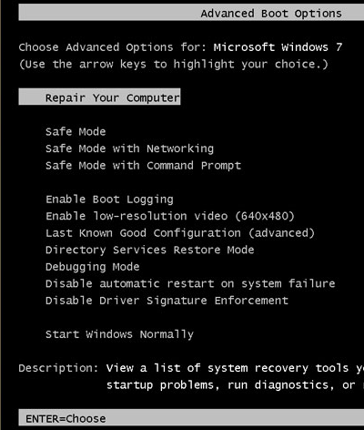
Windows 7 Advanced Boot Options
Press F8 during startup
"Debugging Mode"

Slide 9
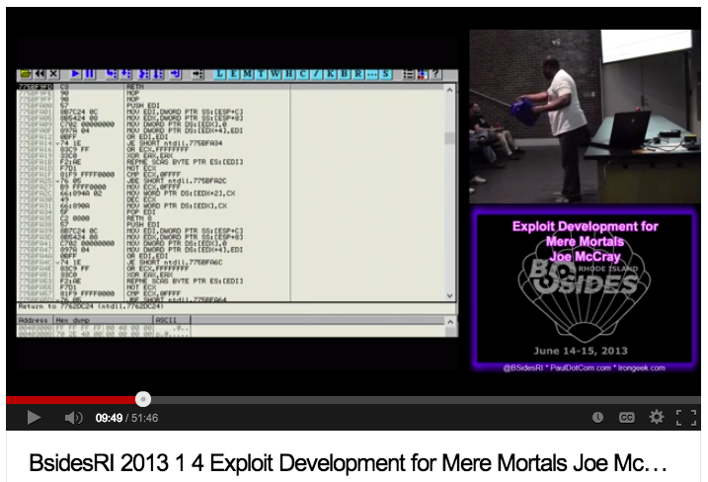
Good Intro to OllyDbg
Link Ch 8a

Slide 10
Which item below requires two computers connected together?
Source-level debugger
Assembly-level debugger
Kernel-mode debugging
User-mode debugging
More than one of the above

Slide 11
Which item below is almost never used by malware analysts?
Source-level debugger
Assembly-level debugger
Disassembler
User-mode debugging
More than one of the above

Slide 12
Which item below is suggested by Windows automatically after it crashes?
Source-level debugger
Ollydbg
Kernel-mode debugging
User-mode debugging
More than one of the above

Slide 13
Using a Debugger

Slide 14
Two Ways
Start the program with the debugger
  It stops running immediately prior to the execution of its entry point
Attach a debugger to a program that is already running
  All its threads are paused
  Useful to debug a process that is affected by malware

Slide 15
Single-Stepping
Simple, but slow
Don't get bogged down in details

Slide 16
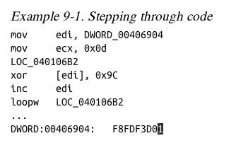
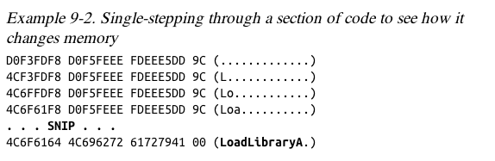
Example
This code decodes the string with XOR

Slide 17
Stepping-over v. Stepping-Into
Single step executes one instruction
Step-over call instructions
  Completes the call and returns without pausing
  Decreases the amount of code you need to analyze
  Might miss important functionality, especially if the function never returns
Step-into a call
  Moves into the function and stops at its first command

Slide 18
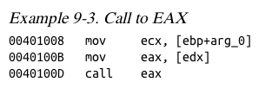
Pausing Execution with Breakpoints
A program that is paused at a breakpoint is called broken
Example
  You can't tell where this call is going
  Set a breakpoint at the call and see what's in eax

Slide 19
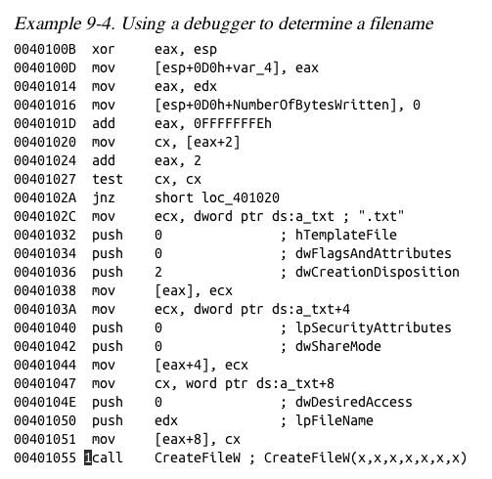
This code calculates a filename and then creates the file
Set a breakpoint at CreateFileW and look at the stack to see the filename

Slide 20
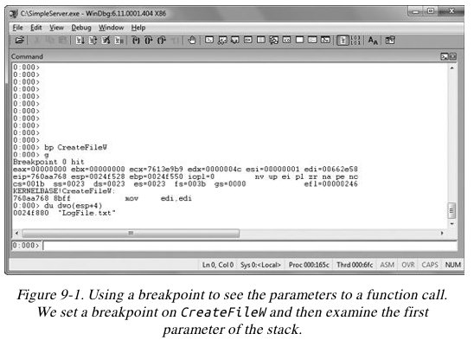

WinDbg

Slide 21
Encrypted Data
Suppose malware sends encrypted network data
Set a breakpoint before the data is encrypted and view it

Slide 22
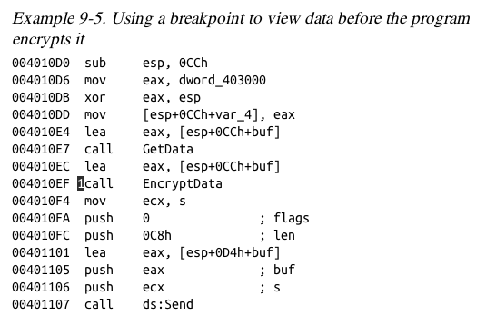

Slide 23
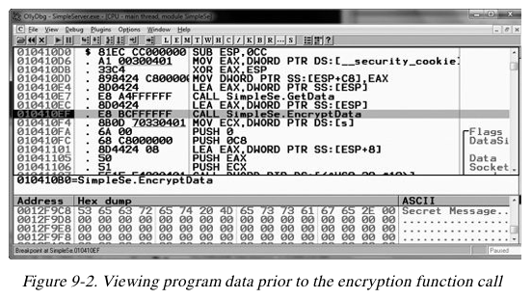
OllyDbg

Slide 24
Types of Breakpoints
Software execution
Hardware execution
Conditional

Slide 25
Software Execution Breakpoints
The default option for most debuggers
Debugger overwrites the first byte of the instruction with 0xCC
  The instruction for INT 3
  An interrupt designed for use with debuggers
  When the breakpoint is executed, the OS generates an exception and transfers control to the debugger

Slide 26
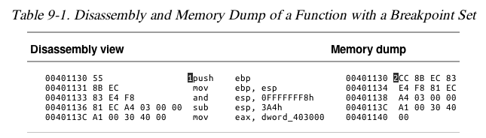
Memory Contents at a Breakpoint
There's a breakpoint at the push instruction
Debugger says it's 0x55, but it's really 0xCC

Slide 27
When Software Execution Breakpoints Fail
If the 0xCC byte is changed during code execution, the breakpoint won't occur
If other code reads the memory containing the breakpoint, it will read 0xCC instead of the original byte
Code that verifies integrity will notice the discrepancy

Slide 28
Hardware Execution Breakpoints
Uses four hardware Debug Registers
  DR0 through DR3 – addresses of breakpoints
  DR7 stores control information
The address to stop at is in a register
Can break on access or execution
  Can set to break on read, write, or both
No change in code bytes

Slide 29
Hardware Execution Breakpoints
Running code can change the DR registers, to interfere with debuggers
General Detect flag in DR7
  Causes a breakpoint prior to any mov instruction that would change the contents of a Debug Register
  Does not detect other instructions, however

Slide 30
Conditional Breakpoints
Breaks only if a condition is true
  Ex: Set a breakpoint on the GetProcAddress function
  Only if parameter being passed in is RegSetValue
Implemented as software breakpoints
  The debugger always receives the break
  If the condition is not met, it resumes execution without alerting the user

Slide 31
Conditional Breakpoints
Conditional breakpoints take much longer than ordinary instructions
A conditional breakpoint on a frequently-accessed instruction can slow a program down
Sometimes so much that it never finishes

Slide 32
What type of breakpoint uses Interrupt #3?
Software execution breakpoint
Hardware execution breakpoint
Conditional breakpoint
More than one of the above
None of the above

Slide 33
What type of breakpoint may make a program run slowly?
Software execution breakpoint
Hardware execution breakpoint
Conditional breakpoint
More than one of the above
None of the above

Slide 34
What is the most common type of breakpoint?
Software execution breakpoint
Hardware execution breakpoint
Conditional breakpoint
More than one of the above
None of the above

Slide 35
Which item might miss important functionality?
Single-step
Step-over
Step-into
Breakpoint
More than one of the above

Slide 36
What type of breakpoint changes the binary code?
Software execution breakpoint
Hardware execution breakpoint
Conditional breakpoint
More than one of the above
None of the above

Slide 37
What type of breakpoint uses the DR registers?
Software execution breakpoint
Hardware execution breakpoint
Conditional breakpoint
More than one of the above
None of the above

Slide 38
Exceptions

Slide 39
Exceptions
Used by debuggers to gain control of a running program
Breakpoints generate exceptions
Exceptions are also caused by
  Invalid memory access
  Division by zero
  Other conditions

Slide 40
First- and Second-Chance Exceptions
When a exception occurs while a debugger is attached
  The program stops executing
  The debugger is given first chance at control
  Debugger can either handle the exception, or pass it on to the program
  If it's passed on, the program's exception handler takes it

Slide 41
Second Chance
If the application doesn't handle the exception
The debugger is given a second chance to handle it
  This means the program would have crashed if the debugger were not attached
In malware analysis, first-chance exceptions can usually be ignored
Second-chance exceptions cannot be ignored
  They usually mean that the malware doesn't like the environment in which it is running

Slide 42
Common Exceptions
INT 3 (Software breakpoint)
Single-stepping in a debugger is implemented as an exception
  If the trap flag in the flags register is set,
  The processor executes one instruction and then generates an exception
Memory-access violation exception
  Code tries to access a location that it cannot access, either because the address is invalid or because of access-control protections

Slide 43
Common Exceptions
Violating Privilege Rules
  Attempt to execute privileged instruction with outside privileged mode
  In other words, attempt to execute a kernel mode instruction in user mode
  Or, attempt to execute Ring 0 instruction from Ring 3

Slide 44
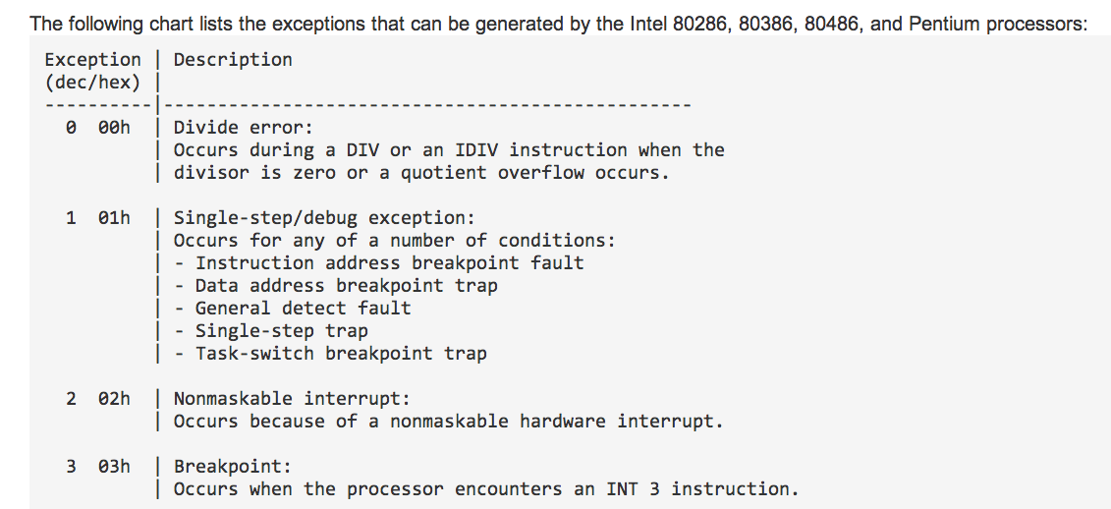
List of Exceptions
Link Ch 8b

Slide 45
Modifying Execution with a Debugger

Slide 46
Skipping a Function
You can change control flags, the instruction pointer, or the code itself
You could avoid a function call by setting a breakpoint where at the call, and then changing the instruction pointer to the instruction after it
  This may cause the program to crash or malfunction, or course

Slide 47
Testing a Function
You could run a function directly, without waiting for the main code to use it
  You will have to set the parameters
  This destroys a program's stack
  The program won't run properly when the function completes

Slide 48
Modifying Program Execution in Practice

Slide 49
Real Virus
Operation depends on language setting of a computer
  Simplified Chinese
    Uninstalls itself & does no harm
  English
    Display pop-up "Your luck's no good"
  Japanese or Indonesian
    Overwrite the hard drive with random data

Slide 50
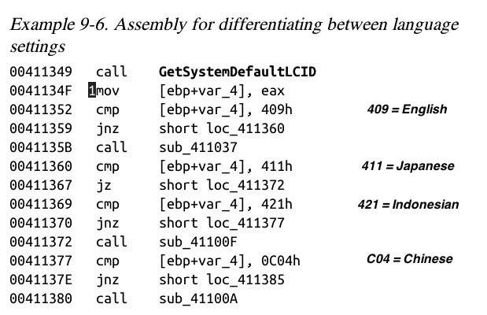
Break at 1; Change Return Value

Slide 51
Which item below handles exceptions during normal program execution?
First chance
Second chance
SEH
INT 3
Trap flag

Slide 52
Which item is used for single-stepping?
First chance
Second chance
SEH
INT 3
Trap flag

Slide 53
Which type of exception doesn't stop code execution and can usually be ignored?
First chance
Second chance
Invalid memory access
Privilege violation

Slide 54
A ring 3 process tries to access hardware directly. What exception will be thrown?
First chance
Second chance
Invalid memory access
Privilege violation

